Slide 1
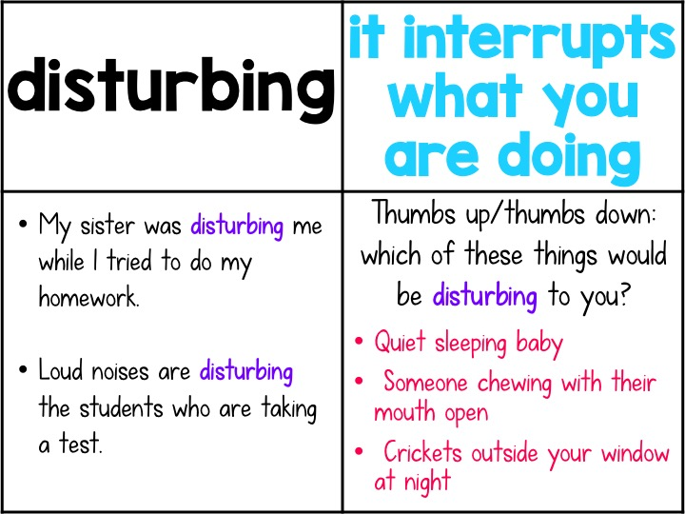
I often find it disturbing when ____________, because ____________.
I do not find __________ disturbing, in fact I find it rather pleasant.

Slide 2
I struggled when I ___________, because __________.
I no longer struggle when I ___________, because __________.

Slide 3
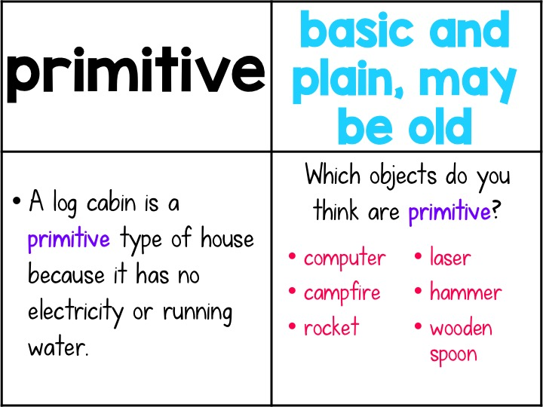
I would consider a _________ to be a primitive tool.

Slide 5
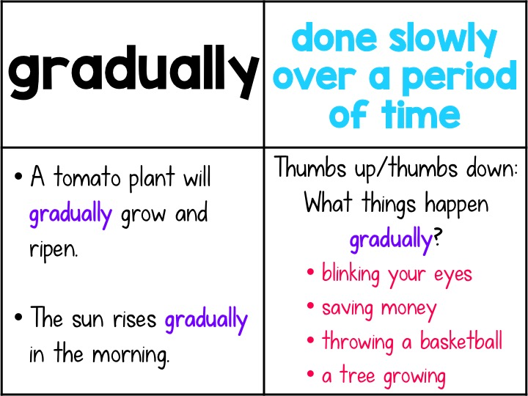
I gradually filled __________ with ________, being careful not to make a mess.
I gradually emptied the __________ because ____________.

Slide 8
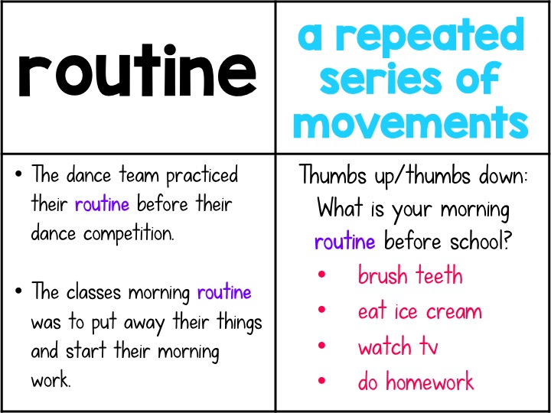

Slide 10
